Slide 1
Course: DS5002 Data Science Tools and Techniques
Data Preprocessing
Dr. Safdar Ali
Explore and discuss the process of data cleaning, with understanding of its importance, common challenges, and effective techniques along with data transformation.

Slide 2
NumPy (Numerical Python)
NumPy (Numerical Python) is a fundamental library for numerical computing in Python.
It provides support for large multidimensional arrays and matrices, along with a collection of mathematical functions to operate on these arrays.
Overview of essential NumPy functions

Slide 3
Creating Arrays
NumPy arrays can be created in following ways:
np.array([list]): Creates a one-dimensional array from a list.
np.zeros((m, n)): Creates an m×n matrix filled with zeros.
np.ones((m, n)): Creates an m×n matrix filled with ones.
np.eye(n): Creates an identity matrix of size n×n.
np.arange(start, stop, step): Creates an array with values in the given range.
np.linspace(start, stop, num): Generates num equally spaced values between start and stop.

Slide 4
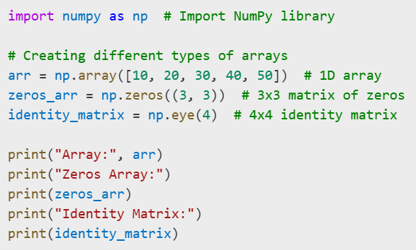
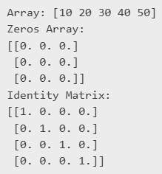
Example
Output:

Slide 5
Generating Random Numbers
NumPy functions for generation of random values:
np.random.randint(low, high, size): Generates random integers within a range.
np.random.rand(m, n): Generates an m×n array of random floats between 0 and 1.
np.random.randn(m, n): Generates normally distributed random numbers.

Slide 6
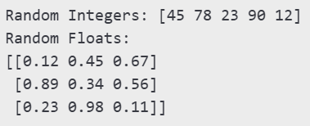
Example
# Generating random numbers
rand_ints = np.random.randint(1, 100, 5)
# 5 random integers between 1 and 100
rand_floats = np.random.rand(3, 3)
# 3x3 matrix of random floats
print("Random Integers:", rand_ints)
print("Random Floats:")
print(rand_floats)
Output
(varies due to randomness)

Slide 7

Basic Array Operations
Mathematical operations directly on arrays.
Addition, subtraction, multiplication, and division can be performed element-wise.
# Performing arithmetic operations
arr = np.array([1, 2, 3, 4, 5])
print("Array Addition:", arr + 5)
# Adds 5 to each element
print("Array Multiplication:", arr * 2)
Output

Slide 8

Trigonometric and Logarithmic Functions
np.sin(x), np.cos(x), np.tan(x): Trigonometric functions.
np.exp(x), np.log(x): Exponential and logarithmic functions.
angles = np.array([0, 30, 45, 60, 90])
# Angles in degrees
radians = np.radians(angles)
# Convert degrees to radians
print("Sine values:", np.sin(radians))
print("Cosine values:", np.cos(radians))
Output

Slide 9
Statistical Functions
np.mean(array): Computes the mean.
np.median(array): Computes the median.
np.std(array): Computes the standard deviation.
np.var(array): Computes the variance.
np.max(array), np.min(array): Finds the maximum and minimum values.

Slide 10
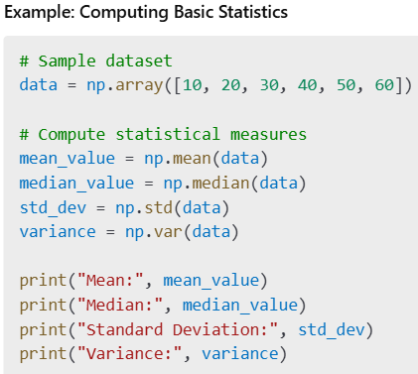
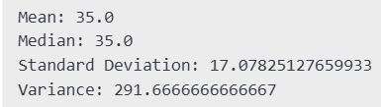
Output

Slide 11
Advanced Data Science Functions
np.polyfit(x, y, deg): Performs polynomial regression fitting.
np.corrcoef(x, y): Computes the Pearson correlation coefficient.
np.linalg.inv(matrix): Computes the inverse of a matrix.
np.linalg.eig(matrix): Computes the eigenvalues and eigenvectors of a matrix.

Slide 12
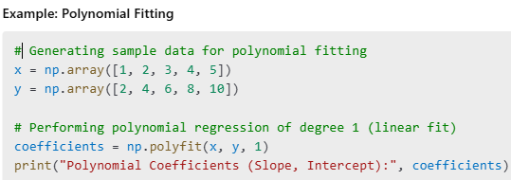

Output

Slide 13

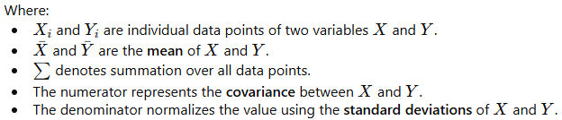
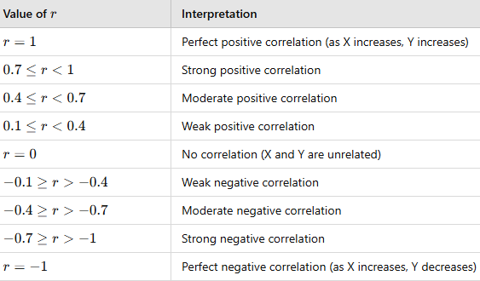
Pearson correlation coefficient
A statistical measure that quantifies the strength and direction of the linear relationship between two numerical variables and ranges from -1 to 1

Slide 14
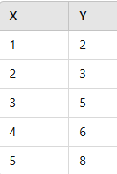
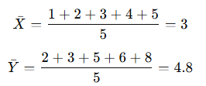
Example
We calculate each term in the formula, substitute values, and compute r. The result equal to 0.97, indicating a strong positive correlation.

Slide 15
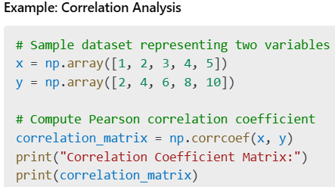

Output

Slide 16
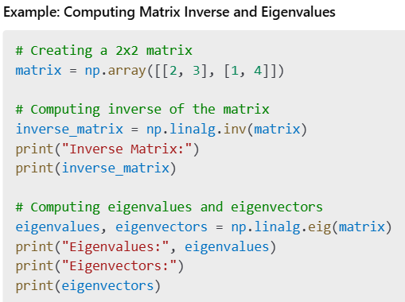
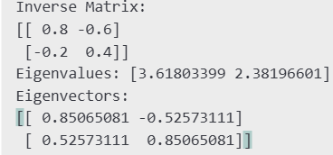
Output

Slide 17
So for, we have discussed and practiced basic NumPy functions with advanced techniques important for data science, including polynomial regression, correlation analysis, and linear algebra operations like matrix inversion and eigenvalue decomposition.
This practice enhanced the analytical capabilities to handle complex datasets using powerful tools for numerical computation and statistical analysis.

